Slide 1
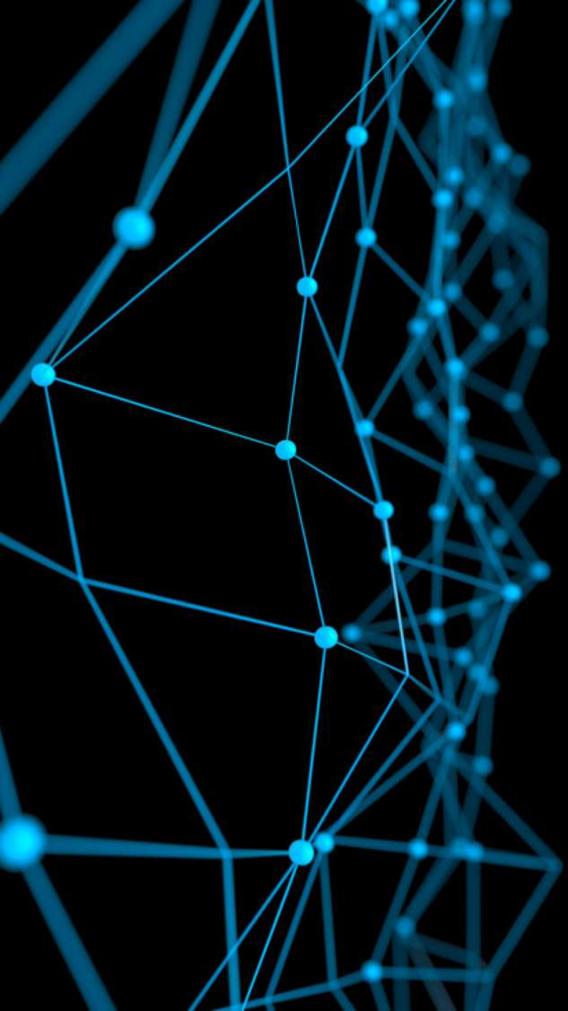
Deep Learning for Computer Vision
Convolution Neural Network: In Practice
June 2019

Slide 2
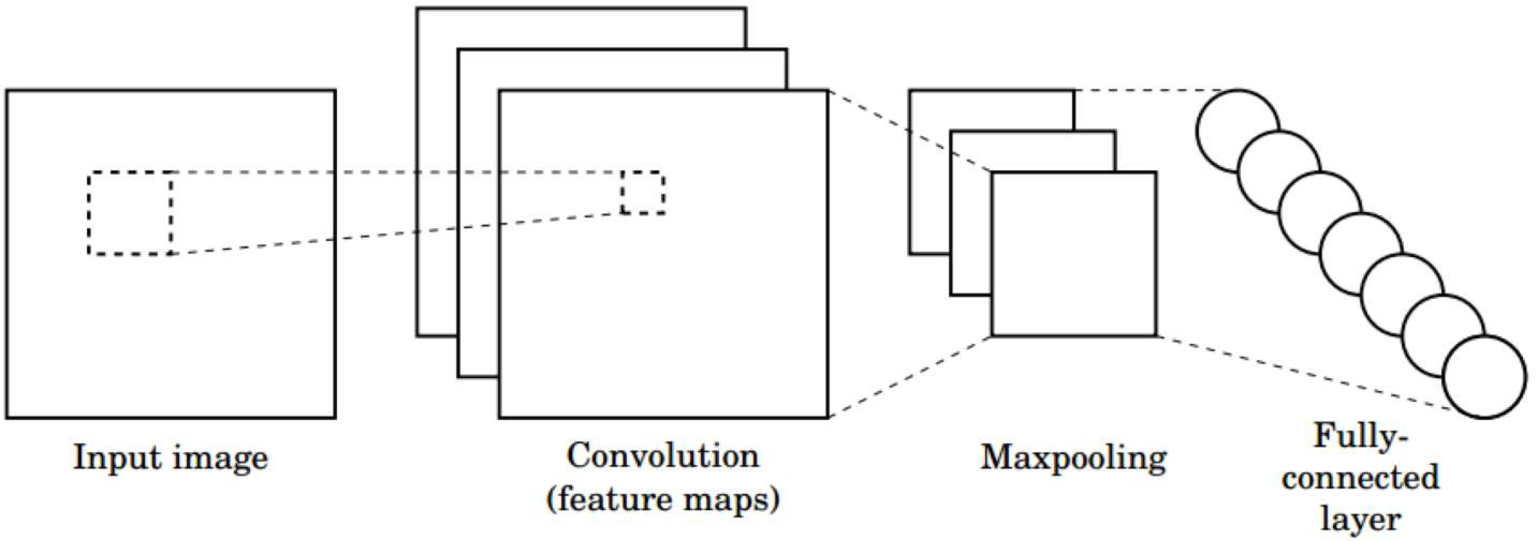
CNNs for Classification
Convolution: Apply filters with learned weights to generate feature maps.
Non-linearity: Often ReLU.
Pooling: Downsampling operation on each feature map.
Train model with image data.
Learn weights of filters in convolutional layers.

Slide 3
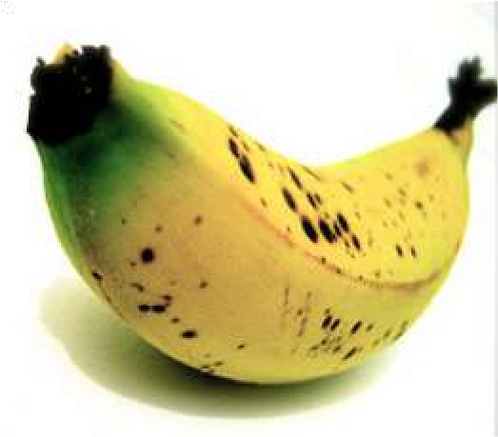
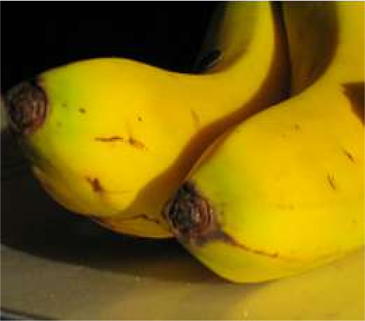
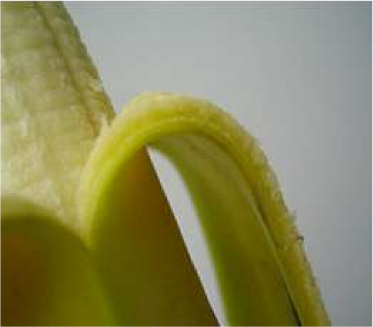
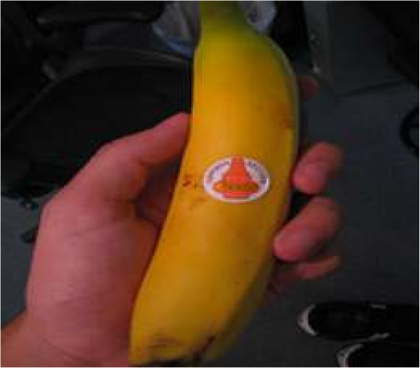
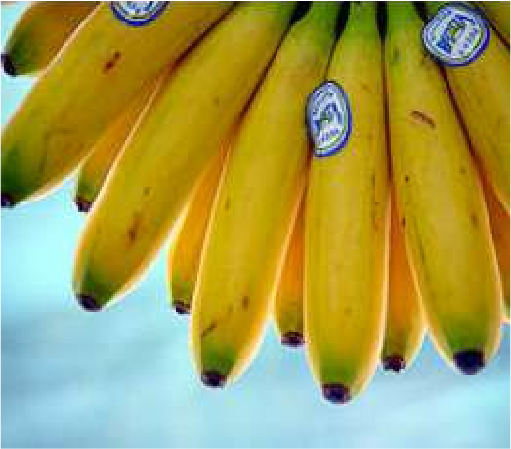
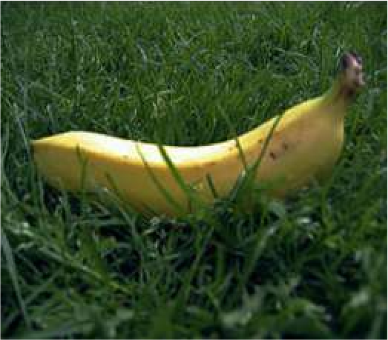
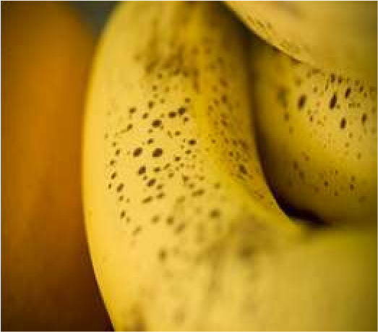
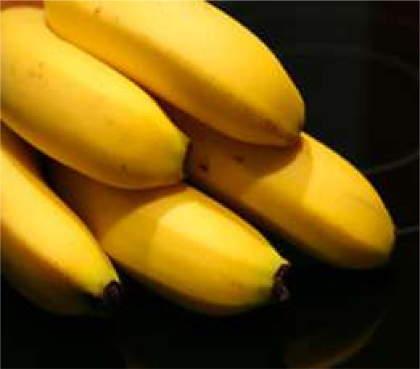
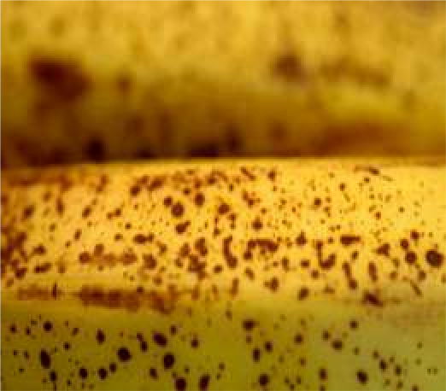
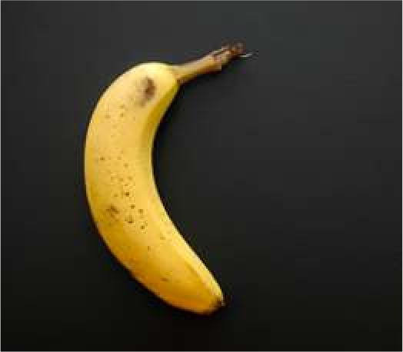
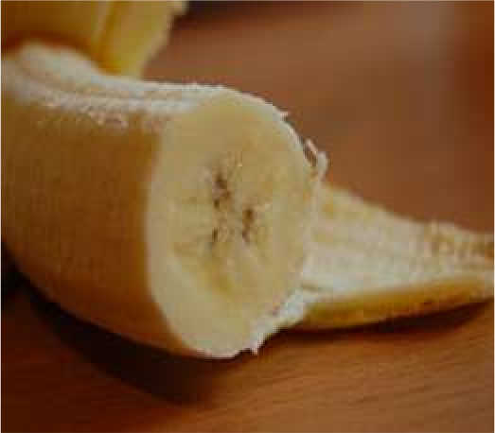
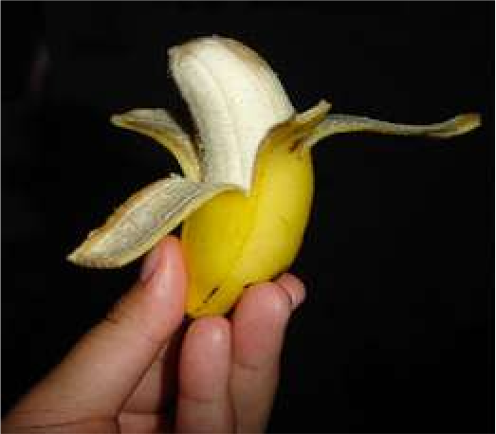
ImageNet Dataset
Dataset of over 14 million images across 21,841 categories
“Elongated crescent-shaped yellow fruit with soft sweet flesh”
1409 pictures of bananas.

Slide 4
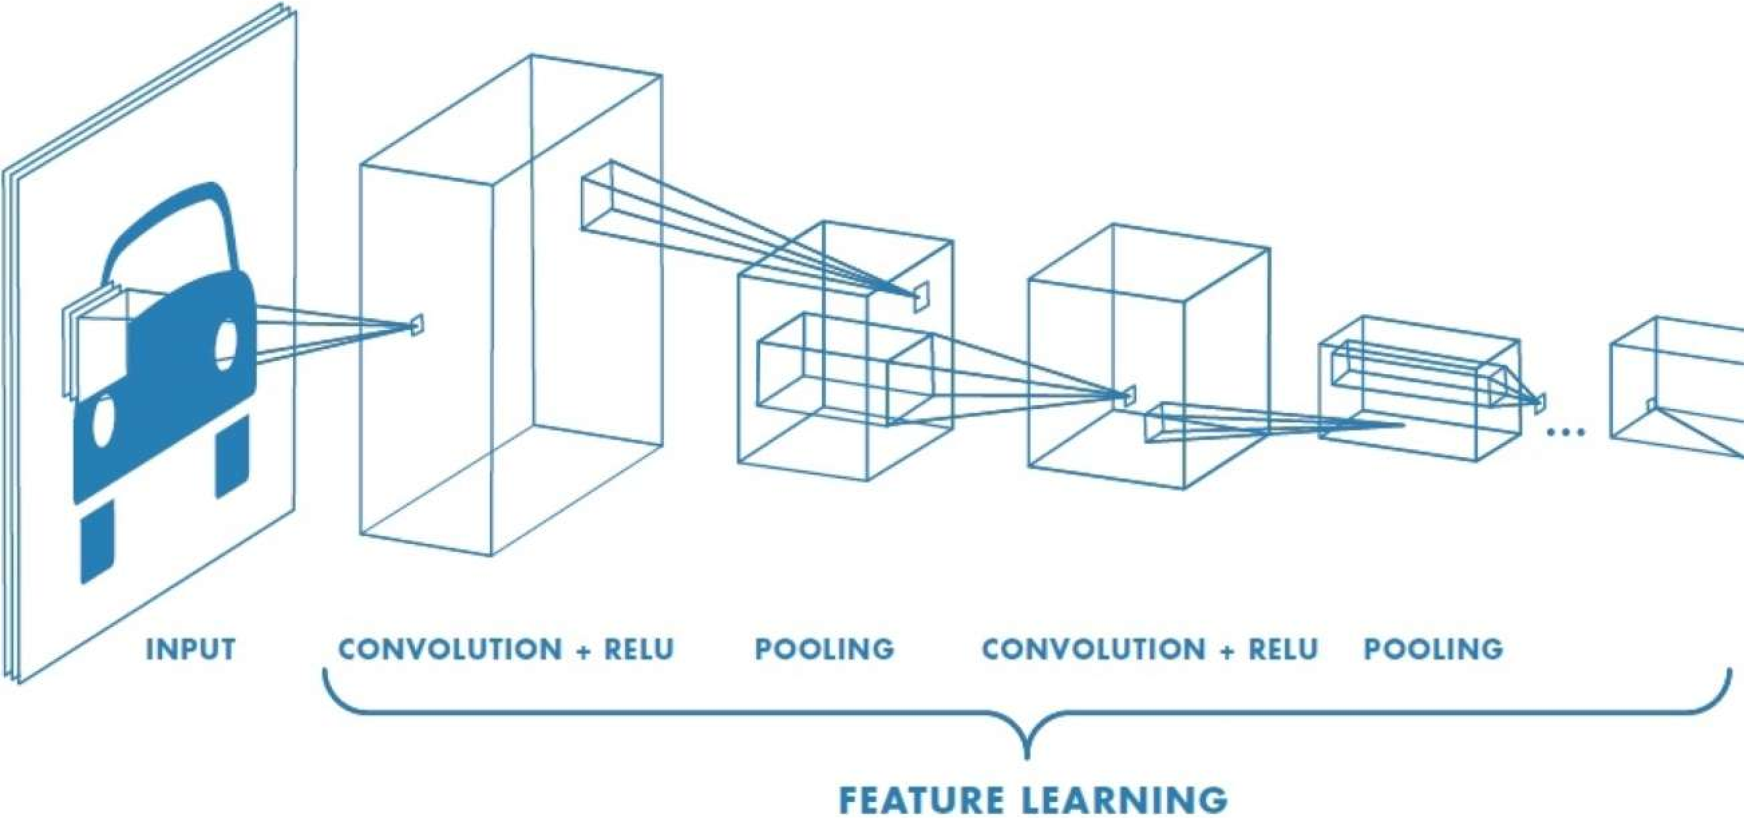
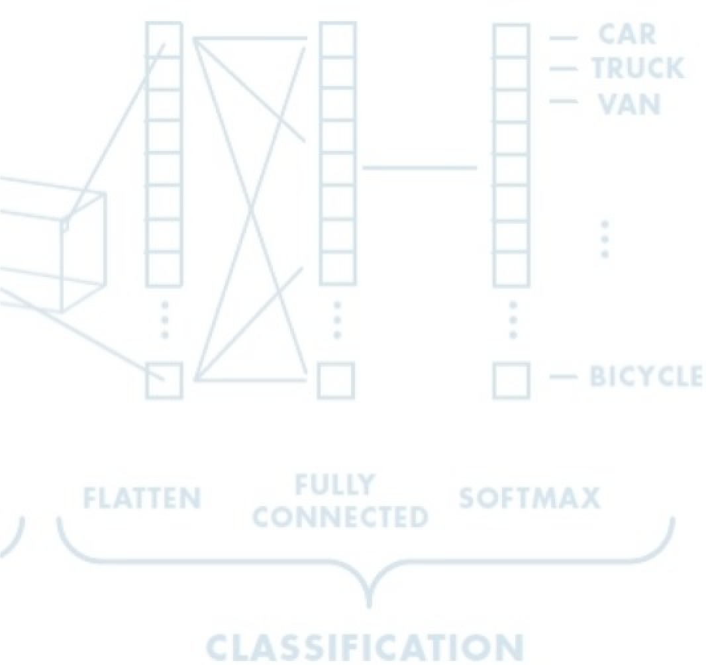
An Architecture for Many Applications
Object detection with R-CNNs Segmentation with fully convolutional networks
Image captioning with RNNs

Slide 5
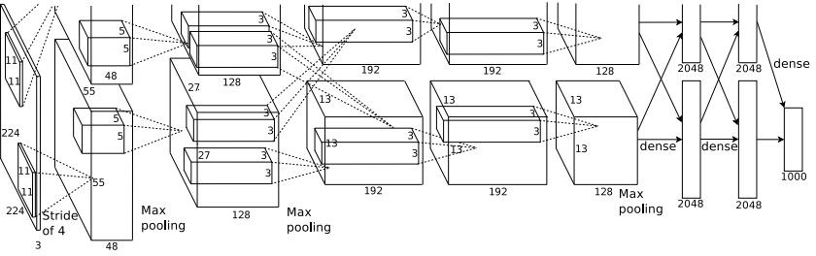
Case Study: AlexNet
[Krizhevsky et al. 2012]
Architecture:
CONV1 MAX POOL1 NORM1 CONV2 MAX POOL2 NORM2 CONV3 CONV4 CONV5
Max POOL3 FC6
FC7 FC8
Lecture 9 - 5

Slide 6
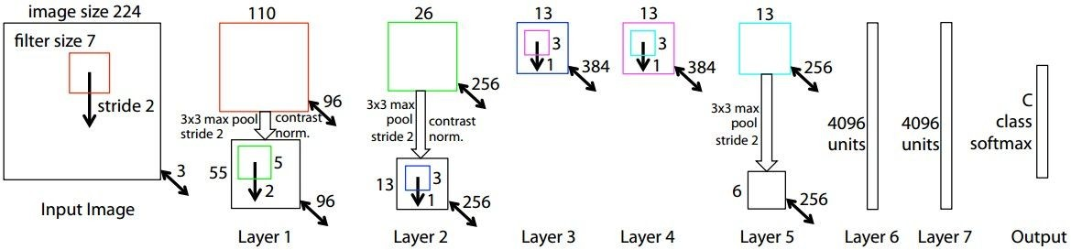
ZFNet
[Zeiler and Fergus, 2013]
TODO: remake figure
AlexNet but:
CONV1: change from (11x11 stride 4) to (7x7 stride 2) CONV3,4,5: instead of 384, 384, 256 filters use 512, 1024, 512
ImageNet top 5 error: 16.4% -> 11.7%
Fei-Fei Li & Justin Johnson & Serena Yeung Lecture 9 - May 2, 2017

Slide 7
Case Study: VGGNet
[Simonyan and Zisserman, 2014]
Softmax
FC 1000
FC 4096
FC 4096
Pool
3x3 conv, 512
3x3 conv, 512
3x3 conv, 512
3x3 conv, 512
Pool
3x3 conv, 512
3x3 conv, 512
3x3 conv, 512
3x3 conv, 512
Pool
3x3 conv, 256
3x3 conv, 256
Pool
3x3 conv, 128
3x3 conv, 128
Pool
3x3 conv, 64
3x3 conv, 64
Input
Softmax
FC 1000
FC 4096
FC 4096
Pool
3x3 conv, 512
3x3 conv, 512
3x3 conv, 512
Pool
3x3 conv, 512
3x3 conv, 512
Small filters, Deeper networks
8 layers (AlexNet)
-> 16 - 19 layers (VGG16Net)
Only 3x3 CONV stride 1, pad 1 and 2x2 MAX POOL stride 2
Softmax
FC 1000
FC 4096
FC 4096
Pool
3x3 conv, 256
3x3 conv, 384
Pool
3x3 conv, 384
Pool
5x5 conv, 256
11x11 conv, 96
Input
3x3 conv, 512
Pool
3x3 conv, 256
3x3 conv, 256
Pool
3x3 conv, 128
3x3 conv, 128
Pool
3x3 conv, 64
3x3 conv, 64
Input
11.7% top 5 error in ILSVRC’13 (ZFNet)
-> 7.3% top 5 error in ILSVRC’14
AlexNet
VGG16
VGG19
Fei-Fei Li & Justin Johnson & Serena Yeung Lecture 9 - May 2, 2017

Slide 8
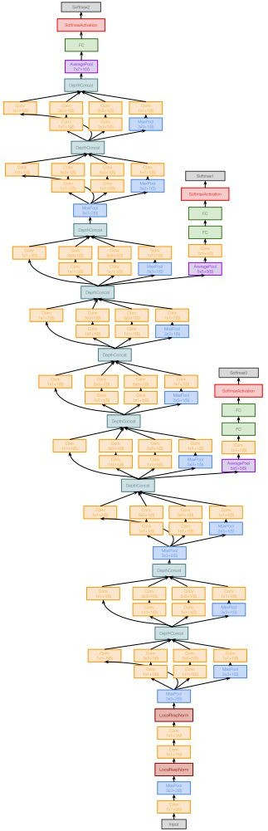
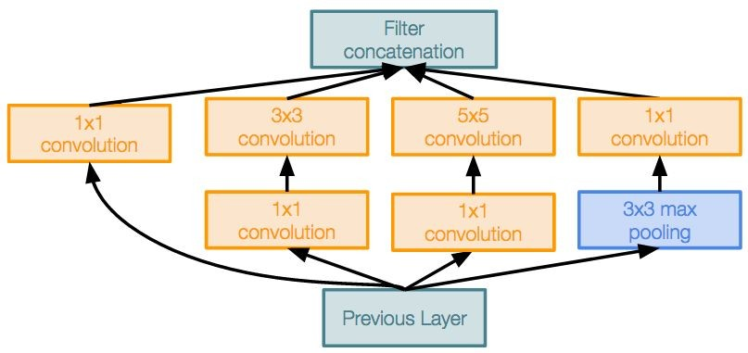
Case Study: GoogLeNet
[Szegedy et al., 2014]
Deeper networks, with computational efficiency
22 layers
Efficient “Inception” module
No FC layers
Only 5 million parameters!
12x less than AlexNet
ILSVRC’14 classification winner (6.7% top 5 error)
Inception module
Fei-Fei Li & Justin Johnson & Serena Yeung Lecture 9 - May 2, 2017

Slide 9
Case Study: ResNet
[He et al., 2015]
Softmax
FC 1000
Pool
3x3 conv, 64
3x3 conv, 64
relu
3x3 conv, 64
Very deep networks using residual connections
3x3 conv, 64
F(x) + x
3x3 conv, 64
3x3 conv, 64
..
.
conv
152-layer model for ImageNet
ILSVRC’15 classification winner (3.57% top 5 error)
Swept all classification and detection competitions in ILSVRC’15 and COCO’15!
3x3 conv, 128
F(x)
X
identity
3x3 conv, 128
relu
3x3 conv, 128
conv
3x3 conv, 128
3x3 conv, 128
3x3 conv, 128 / 2
3x3 conv, 64
X
Residual block
3x3 conv, 64
3x3 conv, 64
3x3 conv, 64
3x3 conv, 64
3x3 conv, 64
Pool
7x7 conv, 64 / 2
Input
Fei-Fei Li & Justin Johnson & Serena Yeung Lecture 9 - May 2, 2017

Slide 10
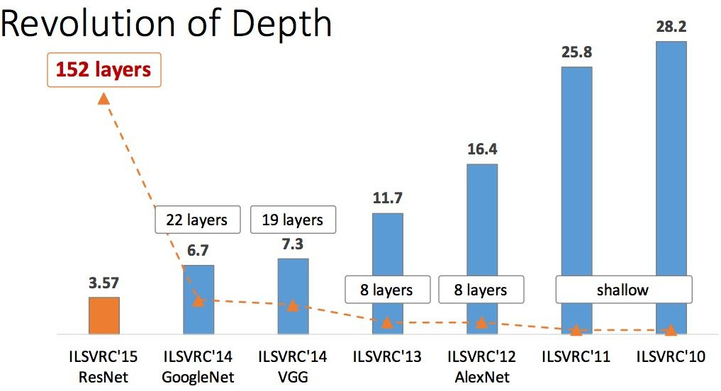
ImageNet Large Scale Visual Recognition Challenge (ILSVRC) winners
Fei-Fei Li & Justin Johnson & Serena Yeung Lecture 9 - May 2, 2017

Slide 11
In practice

Slide 12
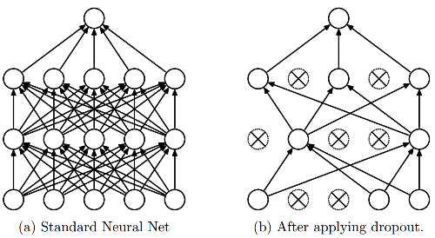
Dropout
Intuition: successful conspiracies
50 people planning a conspiracy
Strategy A: plan a big conspiracy involving 50 people
Likely to fail. 50 people need to play their parts correctly.
Strategy B: plan 10 conspiracies each involving 5 people
Likely to succeed!
Dropout: A simple way to prevent neural networks from overfitting [Srivastava JMLR 2014]

Slide 13
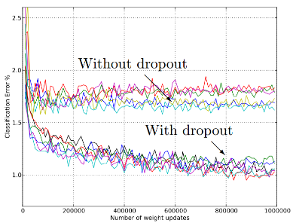
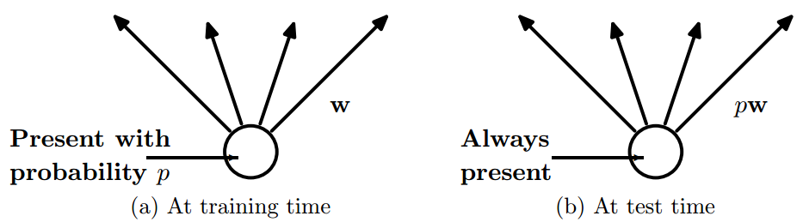
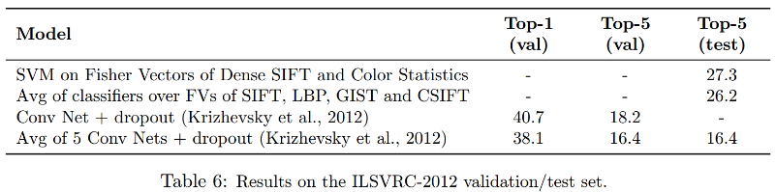
Dropout
Main Idea: approximately combining exponentially many different neural network architectures efficiently
Dropout: A simple way to prevent neural networks from overfitting [Srivastava JMLR 2014]

Slide 14
Data Augmentation (Jittering)

Slide 15
Data Augmentation (Jittering)
What happens if the dataset is small?
Collecting more data (expensive)
Data Augmentation
Data Augmentation: artificially create new training data from existing training data.
This trick is often used to avoiding overfitting.
https://machinelearningmastery.com/how-to-configure-image-data-augmentation-when-training-deep-learning-neural-networks/

Slide 16
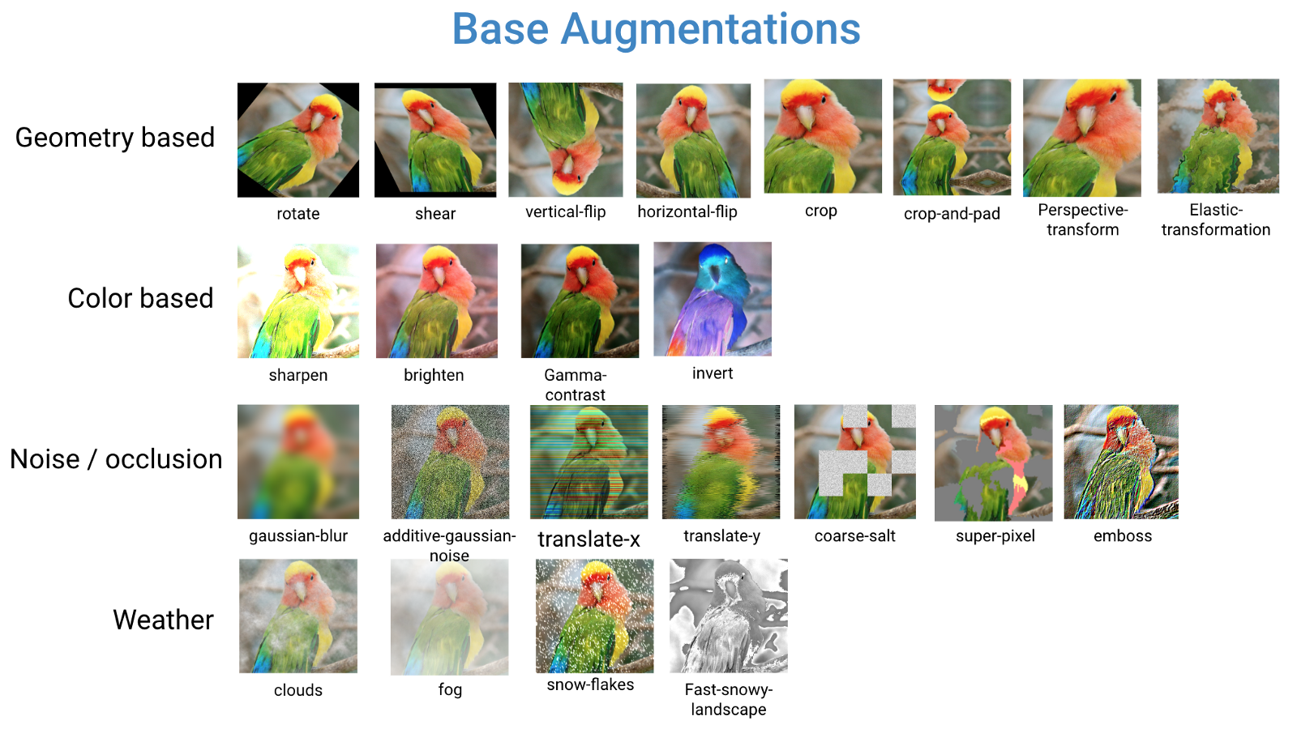
Data Augmentation (Jittering)

Slide 17
Batch Normalization

Slide 18
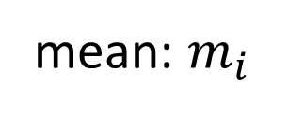
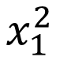
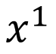
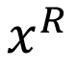
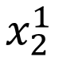
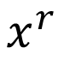
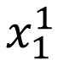
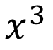
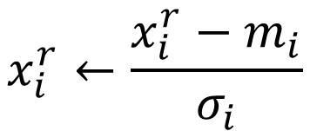
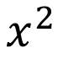
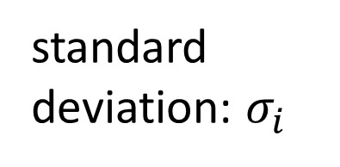
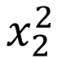
Feature Scaling
$$x^{1}$$
$$x^{2}$$
$$x^{3}$$
$$x^{r}$$
$$x^{R}$$
For each dimension i:
$$x_{1}^{1}$$
$$x_{1}^{2}$$
$$x_{2}^{1}$$
$$x_{2}^{2}$$
……
……
mean: $m_{i}$
……
……
……
……
……
standard deviation: $σ_{i}$
$$x_{i}^{r}←\frac{x_{i}^{r}−m_{i}}{σ_{i}}$$
The means of all dimensions are 0, and the variances are all 1
In general, gradient descent converges much faster with feature scaling than without it.
Notes:
Can we demo this???????????????
https://standardfrancis.wordpress.com/2015/04/16/batch-normalization/

Slide 19
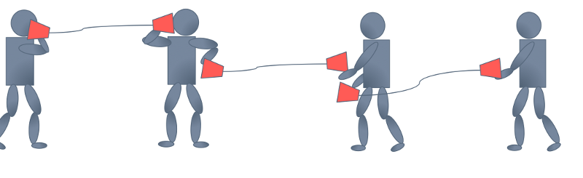



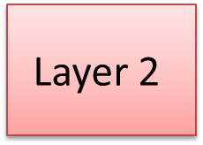
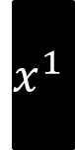
How about Hidden Layer?
Feature Scaling
Feature Scaling ?
Feature Scaling ?
$$x^{1}$$
Layer 1
$$a^{1}$$
$$\text{Layer}\text{ 2}$$
$$a^{2}$$
……
Difficulty: their statistics change during the training …
Batch normalization
Smaller learning rate can be helpful, but the training would be slower.
Internal Covariate Shift
Notes:
Normalizes layer inputs to zero mean and unit variance. whitening.
Naive method: Train on a batch. Update model parameters. Then normalize. Doesn't work: Leads to exploding biases while distribution parameters (mean, variance) don't change.
If we do it this way gradient always ignores the effect that the normalization for the next batch would have
i.e. : “The issue with the above approach is that the gradient descent optimization does not take into account the fact that the normalization takes place”

Slide 20
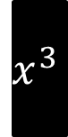

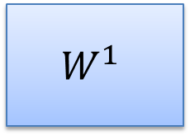


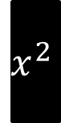

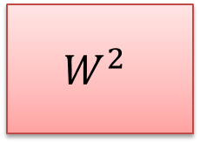

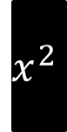
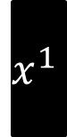
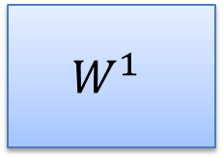





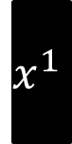

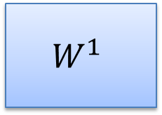


Batch
$$x^{1}$$
$$W^{1}$$
$$z^{1}$$
Sigmoid
$$a^{1}$$
$$W^{2}$$
……
$$x^{2}$$
$$W^{1}$$
$$z^{2}$$
Sigmoid
$$a^{2}$$
$$W^{2}$$
……
$$x^{3}$$
$$W^{1}$$
$$z^{3}$$
Sigmoid
$$a^{3}$$
$$W^{2}$$
……
$$z^{1}$$
$$z^{2}$$
$$z^{3}$$
$$W^{1}$$
$$x^{1}$$
$$x^{2}$$
$$x^{3}$$
Batch
=

Slide 21





Batch normalization
$$μ=\frac{1}{3}\sum_{i=1}^{3}{z^{i}}$$
$$x^{1}$$
$$W^{1}$$
$$z^{1}$$
$$σ=\sqrt{\frac{1}{3}\sum_{i=1}^{3}{{\left(z^{i}−μ\right)}^{2}}}$$
$$x^{2}$$
$$W^{1}$$
$$z^{2}$$
Note: Batch normalization cannot be applied on small batch.
$$x^{3}$$
$$W^{1}$$
$$z^{3}$$
$μ$ and $σ$ depends on $z^{i}$
$$μ$$
$$σ$$

Slide 22








Batch normalization
$${\tilde{z}}^{i}=\frac{z^{i}−μ}{σ}$$
$$x^{1}$$
$$W^{1}$$
$$z^{1}$$
$${\tilde{z}}^{1}$$
Sigmoid
$$a^{1}$$
$$x^{2}$$
$$W^{1}$$
$$z^{2}$$
$${\tilde{z}}^{2}$$
Sigmoid
$$a^{2}$$
$$x^{3}$$
$$W^{1}$$
$$z^{3}$$
$${\tilde{z}}^{3}$$
Sigmoid
$$a^{3}$$
$$μ$$
$$σ$$
$μ$ and $σ$ depends on $z^{i}$

Slide 23







Batch normalization
$${\tilde{z}}^{i}=\frac{z^{i}−μ}{σ}$$
$${\hat{z}}^{i}=γ⨀{\tilde{z}}^{i}+β$$
$$x^{1}$$
$$W^{1}$$
$$z^{1}$$
$${\tilde{z}}^{1}$$
$${\hat{z}}^{1}$$
$$x^{2}$$
$$W^{1}$$
$$z^{2}$$
$${\tilde{z}}^{2}$$
$${\hat{z}}^{2}$$
$$x^{3}$$
$$W^{1}$$
$$z^{3}$$
$${\tilde{z}}^{3}$$
$${\hat{z}}^{3}$$
$$μ$$
$$σ$$
$$β$$
$$γ$$
$μ$ and $σ$ depends on $z^{i}$
Notes:
上學期好多人做!
https://ntumlds.wordpress.com/2017/03/26/r05922005_rrrr/

Slide 24













Batch normalization
Acc
$$μ_{300}$$
$$μ_{100}$$
At testing stage:
$$μ_{1}$$
Updates
$$\tilde{z}=\frac{z−μ}{σ}$$
$$\tilde{z}$$
$${\hat{z}}^{i}=γ⨀{\tilde{z}}^{i}+β$$
$$\hat{z}$$
$$x$$
$$W^{1}$$
$$z$$
$μ$, $σ$ are from batch
$γ$, $β$ are network parameters
We do not have batch at testing stage.
Ideal solution:
Computing $μ$ and $σ$ using the whole training dataset.
Practical solution:
Computing the moving average of $μ$ and $σ$ of the batches during training.
Notes:
上學期好多人做!
https://ntumlds.wordpress.com/2017/03/26/r05922005_rrrr/

Slide 25
Batch normalization - Benefit
BN reduces training times, and make very deep net trainable.
Because of less Covariate Shift, we can use larger learning rates.
Less exploding/vanishing gradients
Especially effective for sigmoid, tanh, etc.
Learning is less affected by initialization.
BN reduces the demand for regularization.
Notes:
Because the means and variances are calculated over batches and therefore every normalized value depends on the current batch. I.e. the network can no longer just memorize values and their correct answers.)

Slide 27
Transfer Learning

Slide 28

What is Transfer Learning?
Improvement of learning in a new task through the transfer of knowledge from a related task that has already been learned.

Slide 29
How to Use Transfer Learning?
Select Source Model: a pre-trained source model is chosen from available models.
Reuse Model: the model pre-trained model can then be used as the starting point for a model on the second task of interest.
Tune Model: optionally, the model may need to be adapted or refined on the input-output pair data available for the task of interest.

Slide 30
When to Use Transfer Learning?
New domain with insufficient data
there is a big pre-existing data pool that can be transferred to this problem.
New dataset is small and similar to original dataset.
train a linear classifier on the features extracted by CNN
New dataset is large and similar to the original dataset
fine-tune through the full network

Slide 31

Benefits of Transfer Learning
Higher start: good starting point
Higher slope: faster improvement
Higher asymptote: Faster convergence
Notes:
ransfer learning is an optimization, a shortcut to saving time or getting better performance.
In general, it is not obvious that there will be a benefit to using transfer learning in the domain until after the model has been developed and evaluated.
Lisa Torrey and Jude Shavlik in their chapter on transfer learning describe three possible benefits to look for when using transfer learning:
Higher start. The initial skill (before refining the model) on the source model is higher than it otherwise would be.
Higher slope. The rate of improvement of skill during training of the source model is steeper than it otherwise would be.
Higher asymptote. The converged skill of the trained model is better than it otherwise would be.

Slide 32
Things to remember
Dropout
Data augmentation
Activation
Batch normalization
Transfer learning

Slide 33
Beyond Classification

Slide 34



Beyond Classification
Semantic Segmentation
Object Detection
Image Captioning
CAT
CAT, DOG, DUCK
The cat is in the grass.
1/29/19

Slide 35

Semantic Segmentation: FCNs
FCN: Fully Convolutional Network.
Network designed with all convolutional layers, with downsampling and upsampling operations
[3,8,9] 1/29/19

Slide 36


Driving Scene Segmentation
Fix reference
[10] 1/29/19

Slide 37

Driving Scene Segmentation
[11, 12] 1/29/19

Slide 38

Object Detection with R-CNNs
R-CNN: Find regions that we think have objects. Use CNN to classify.
[13] 1/29/19

Slide 39




Image Captioning using RNNs
[14,15] 1/29/19

Slide 40




Image Captioning using RNNs
[14,15] 1/29/19

Slide 41
Deep Learning for Computer Vision: Impact and Summary

Slide 42



Data, Data, Data
Airplane
Automobile Bird Cat
Deer Dog
MNIST: handwritten digits
Frog
Horse
ImageNet:
22K categories. 14M images.
Ship
Truck
CIFAR-10
places: natural scenes
1/29/19

Slide 43





Deep Learning for Computer Vision: Impact
1/29/19

Slide 44

Impact: Face Detection
6.S191 Lab!
1/29/19

Slide 45

Impact: Self-Driving Cars

Slide 46

Impact: Healthcare
Identifying facial phenotypes of genetic disorders using deep learning
Gurovich et al., Nature Med. 2019

Slide 47



Deep Learning for Computer Vision: Summary
Foundations
Why computer vision?
Representing images
Convolutions for feature extraction
CNNs
CNN architecture
Application to classification
ImageNet
Applications
Segmentation, object detection, image captioning
Visualization
1/29/19

